Slide 1
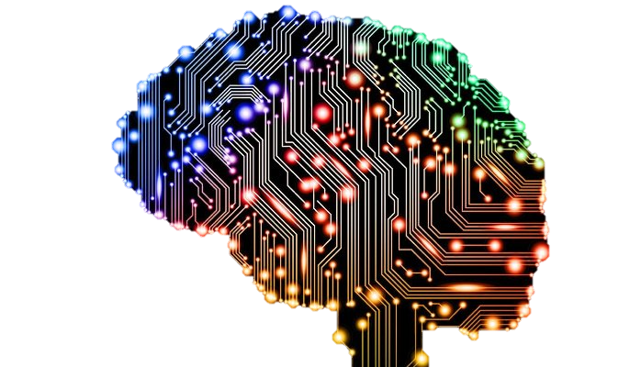
Introduction to Artificial Intelligence CSCE 4310 and 5210 Reinforcement Learning
Dr. Rodney Nielsen
George Mihaila
Director, Human Intelligence and Language Technologies Lab

Slide 2
Reinforcement Learning
Markov Decision Process
Agent Designs
Passive Reinforcement Learning
Direct Utility Estimation
Adaptive Dynamic Programming (ADP)
Active Reinforcement Learning
Q-Learning
Deep Q-Learning
Deep Reinforcement Learning

Slide 3
Reinforcement Learning
Supervised Learning:
Create labeled examples for each state action
Labeled Ex.: feature vector representing state of a game/environment with label indicating which move to make.
Problem? Imitate the player.
Reinforcement Learning:
Use observed rewards to learn an optimal (or nearly optimal) policy for the environment.

Slide 4
Reinforcement Learning
Supervised Learning: y=f(x) –Func Approximation
Reinforcement Learning: y=f(x), z

Slide 5
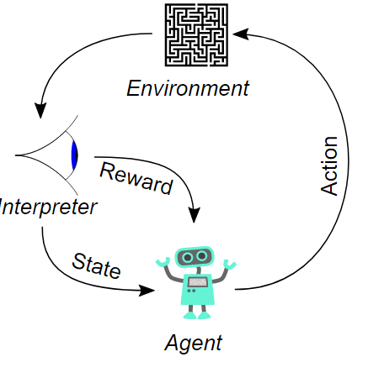
Reinforcement Learning

Slide 6
Reinforcement Learning
We consider building an agent that can observe the state of it’s environment, and a set of actions it can perform to alter the state.
It’s task is to learn a control strategy, or policy for choosing actions that achieve its goals(end states/termination states).
We assume that the goal of the agent can be defined by a reward function.

Slide 7
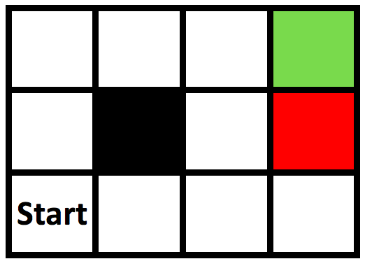
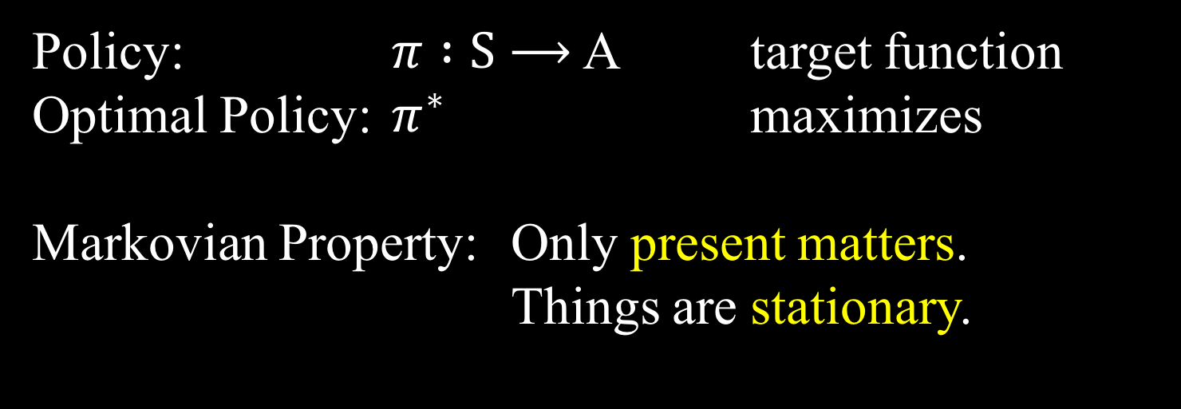
Markov Decision Process
States: S
Actions: A(s), A
Model: T(s,a,s’) ~ P(s’ | s,a)
Reward: R(s), R(s,a), R(s,a,s’)
Policy: $π :S$ $⟶$ A target function
Optimal Policy: $π^{∗}$ maximizes
Markovian Property: Only present matters.
Things are stationary.

Slide 8
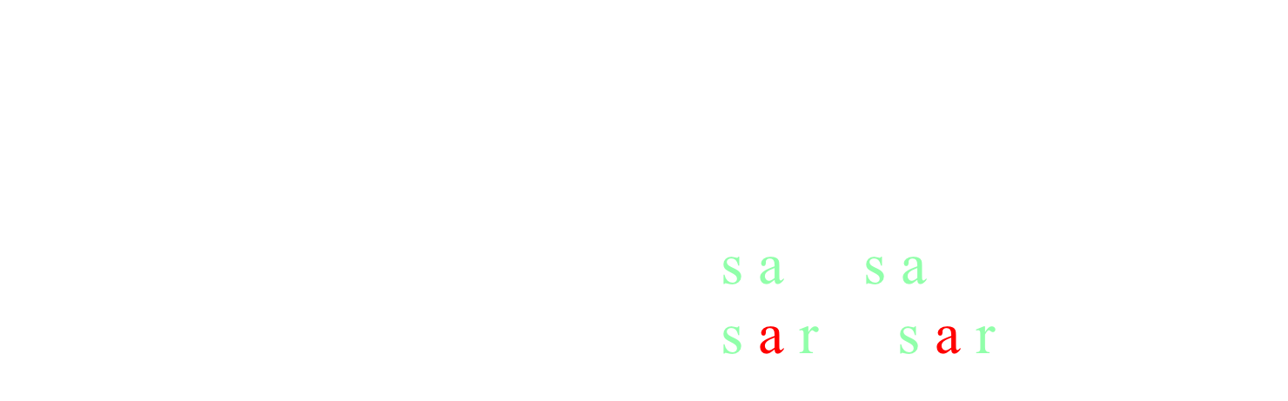
Markov Decision Process
States: S
Actions: A(s), A
Model: T(s,a,s’) ~ P(s’ | s,a)
Reward: R(s), R(s,a), R(s,a,s’)
Policy: $π :S$ $⟶$ A target function
Optimal Policy: $π^{∗}$ maximizes
Supervised Learning: <s,a> <s,a> …
Reinforcement Learning: <s,a,r> <s,a,r> ...

Slide 9
Agent Designs
Utility-based agent learns a utility function on states and uses it to select actions that maximize the expected outcome utility: Model-Base Learning
Q-learning agent learns an action-utility function, or Q-function, giving the expected utility of taking a given action in a given state: Model-Free Learning
Reflex agent learns a policy that maps directly from states to actions.

Slide 10
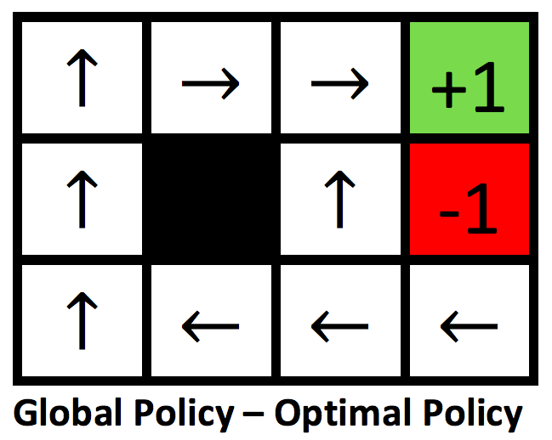
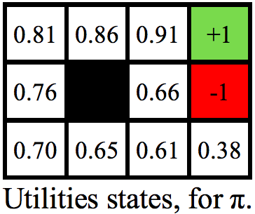
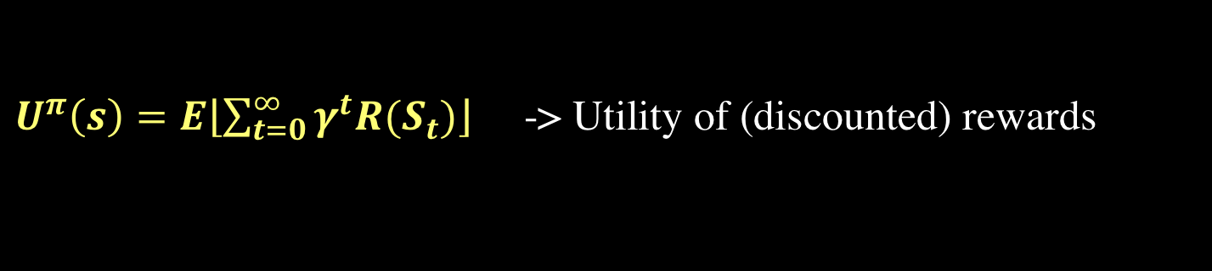
PASSIVE REINFORCEMENT LEARNING
The agent’s policy π is fixed: it always executes the action π(s). Its goal is simply to learn how good the policy is— learn the utility function Uπ(s).
The agent does not know the transition model P(s′|s, a) nor does it know the reward function R(s)
$U^{π}\left(s\right)=E\left\lfloor \sum_{t=0}^{∞}{γ^{t}R(S_{t})}\right\rfloor$ -> Utility of (discounted) rewards

Slide 11
Direct Utility Estimation
Direct utility estimation: the utility of a state is the expected total reward from that state onward (called the expected reward-to-go)
At the end of each sequence, the algorithm calculates the observed reward-to-go for each state and updates the estimated utility for that state accordingly, just by keeping a running average for each state in a table. In the limit of infinitely many trials, the sample average will converge to the true expectation

Slide 12
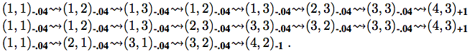
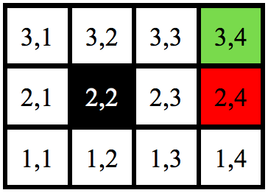
Direct Utility Estimation
Ex: The first trial in the set of three given, provides a sample total reward of 0.72 for state (1,1), two samples of 0.76 and 0.84 for (1,2), two samples of 0.80 and 0.88 for (1,3), and so on

Slide 13

Direct Utility Estimation
Unfortunately, it misses a very important source of information, - the utilities of states are not independent! The utility of each state equals its own reward plus the expected utility of its successor states.
The utility values obey the Bellman equations for a fixed policy:
$$U_{(S)}^{π}= R_{(S)}+γ\sum_{S′}{P_{(S^{′}|s, π_{(S)})}U_{(s^{′})}^{π}}$$
We can view direct utility estimation as searching for U in a hypothesis space that is much larger than it needs to be, in that it includes many functions that violate the Bellman equations. For this reason, the algorithm often converges very slowly.

Slide 14
Adaptive dynamic programming
An adaptive dynamic programming(or ADP) agent takes advantage of the constraints among the utilities of states by learning the transition model that connects them and solving the corresponding Markov decision process using a dynamic programming method.
For a passive learning agent, this means plugging the learned transition model P(s′|s,π(s)) and the observed rewards R(s)into the Bellman equations to calculate the utilities of the states.

Slide 15
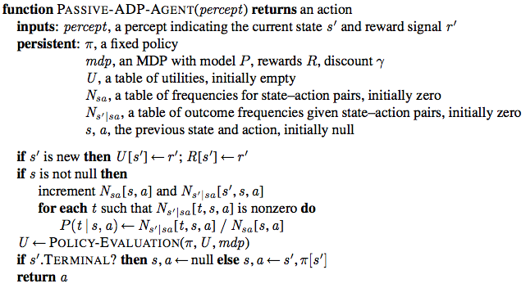
Adaptive dynamic programming

Slide 16
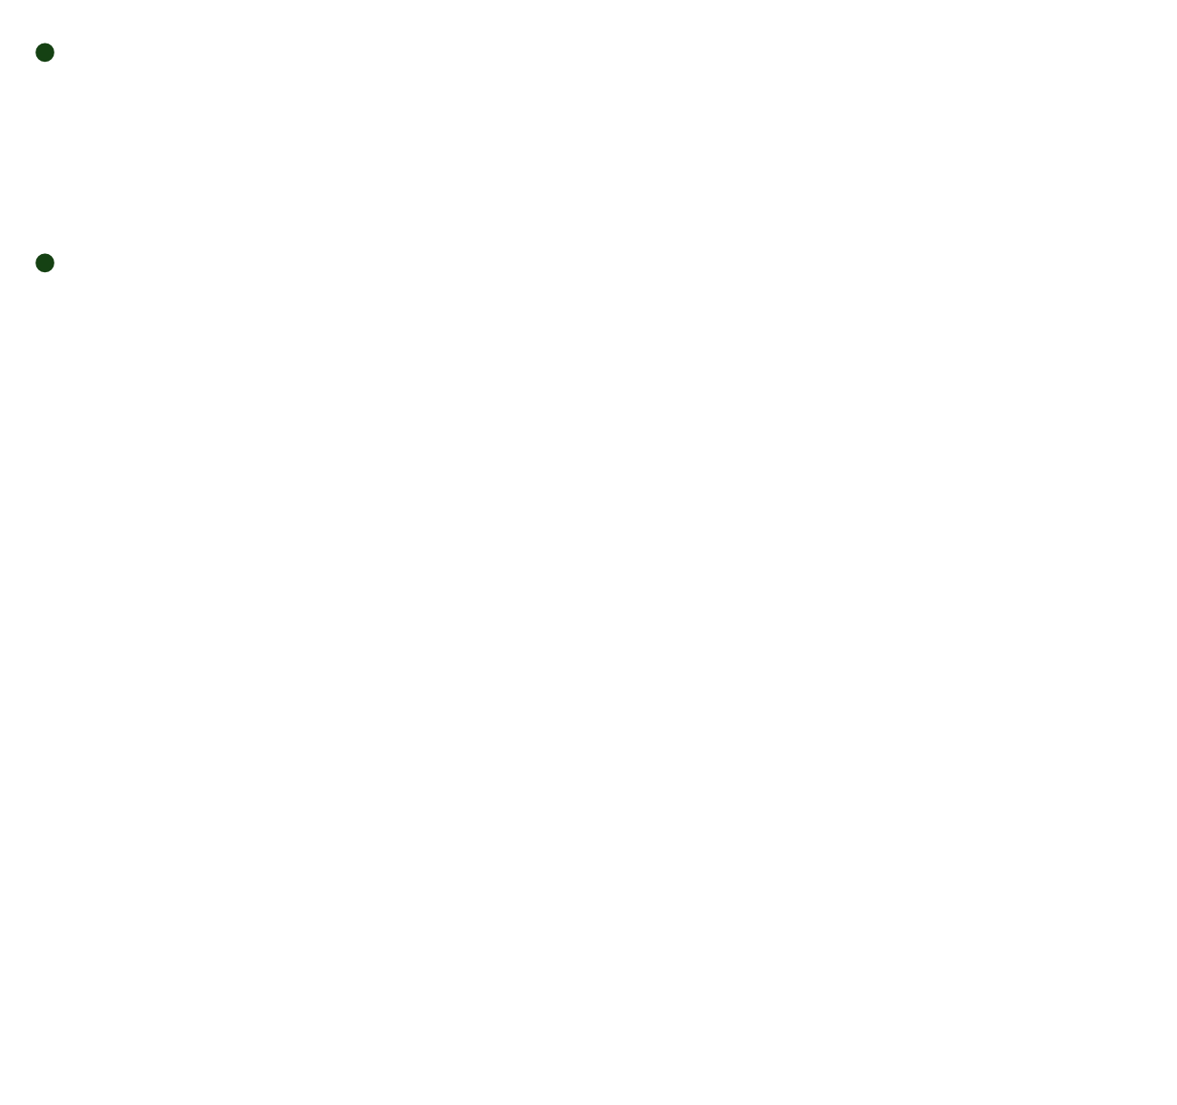
ACTIVE REINFORCEMENT LEARNING
A passive learning agent has a fixed policy that determines its behavior. An active agent must decide what actions to take.
We need to take into account the fact that the agent has a choice of actions. The utilities it needs to learn are those defined by the optimal policy; they obey the Bellman equations:
$$U_{(S)}^{π}= R_{(S)}+γ\sum_{S′}{P_{(S^{′}|s, π_{(S)})}U_{(s^{′})}^{π}}$$

Slide 17
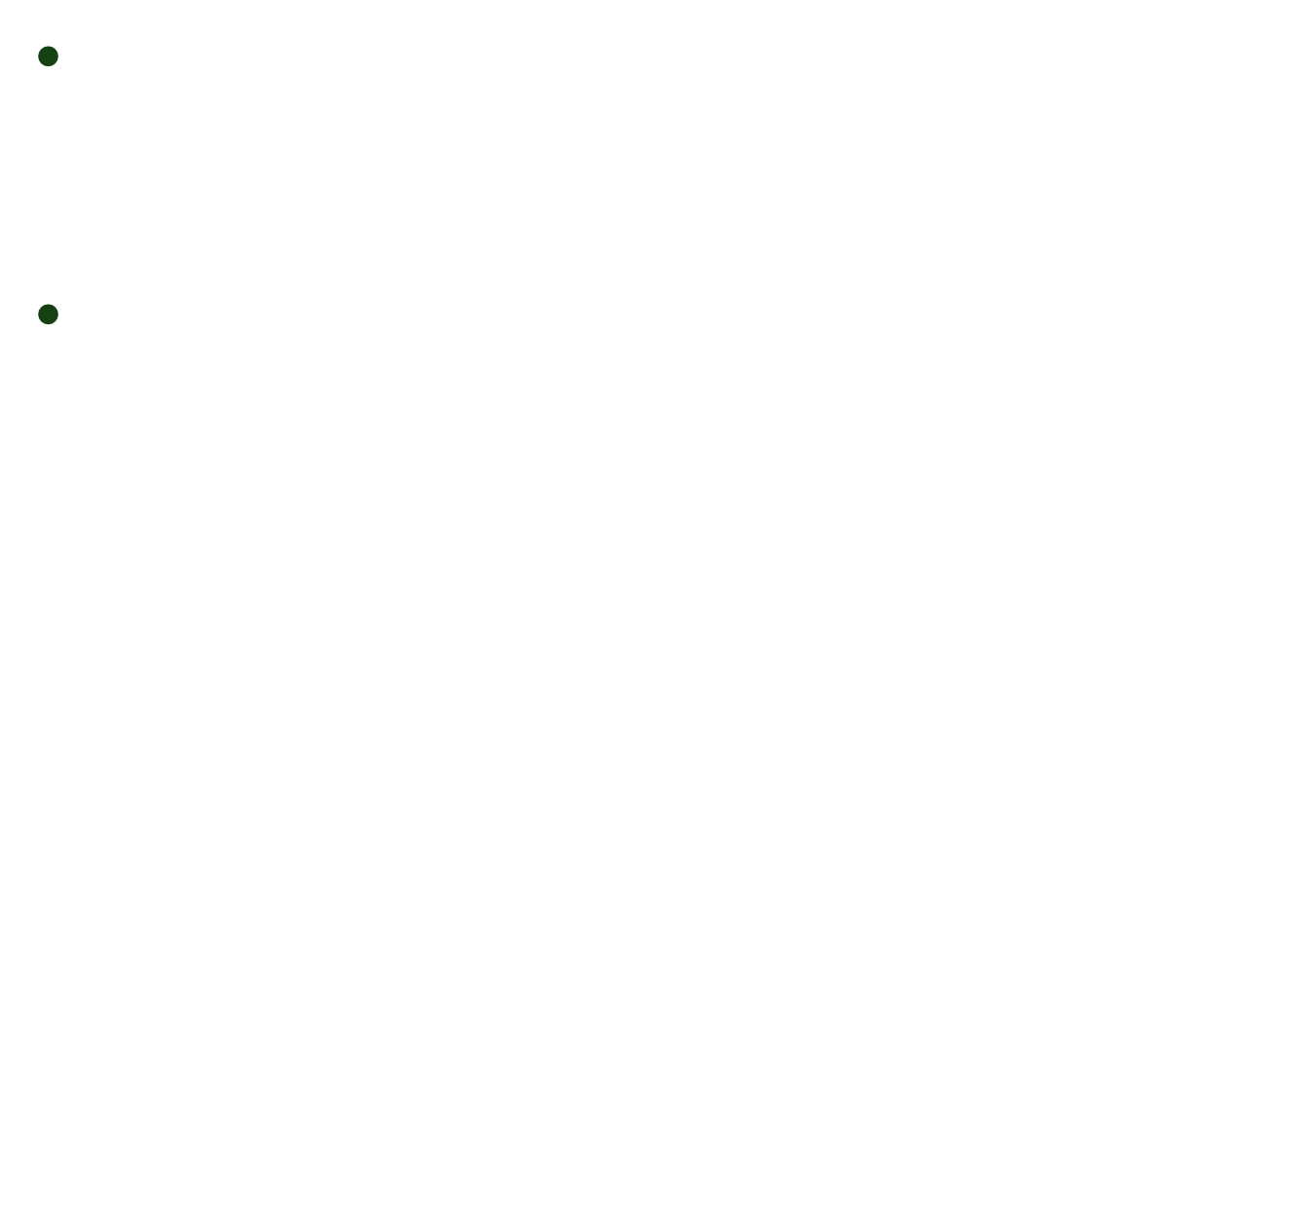
Q-Learning
Q-values are directly related to utility values as follows:
$$U_{(S)}= \max_{a}{Q_{(S,a)}}$$
Does not need a model of the form P(s′|s, a), either for learning or for action selection. We can write a constraint equation that must hold at equilibrium when the Q-values are correct:
$$Q_{(S,a)}= R_{(S)}+ γ \sum_{S′}{P_{(S^{′}|s,a)}\max_{a′}{Q_{(S^{′}, a′)}}}$$

Slide 18
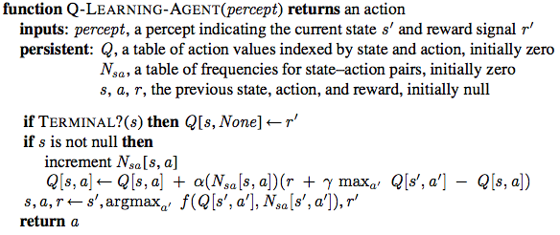
Q-Learning

Slide 19

Deep Q-Learning
Continuous State Space:
$$Q_{(S,a)}←Q_{(S,a)}+ α(R_{\left(S\right)}+γ\max_{a^{′}}{Q_{\left(S^{′},a\right)}}−Q_{\left(S,a\right)})$$

Slide 20
Deep Q-Learning

Slide 21
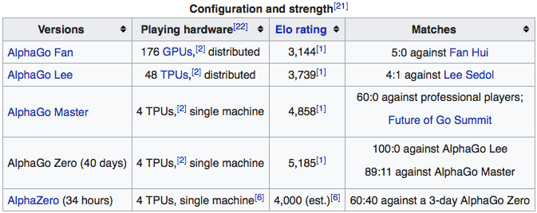
Deep Reinforcement Learning
AlphaGo's team published an article in the journal Nature on October 19 2017, introducing AlphaGo Zero.
By playing games against itself, AlphaGo Zero surpassed the strength of AlphaGo Lee — the program that beat 17 time world champion Lee 100–0 — in three days by winning 100 games to 0, reached the level of AlphaGo Master in 21 days, and exceeded all the old versions in 40 days. AlphaGo Zero did not need any data.

Slide 22
Applications
Play video games: Deep Q-learning
https://www.youtube.com/watch?v=V1eYniJ0Rnk
Play board games: Alpha-go
https://www.youtube.com/watch?v=tXlM99xPQC8

Slide 23
Questions
?

Slide 24
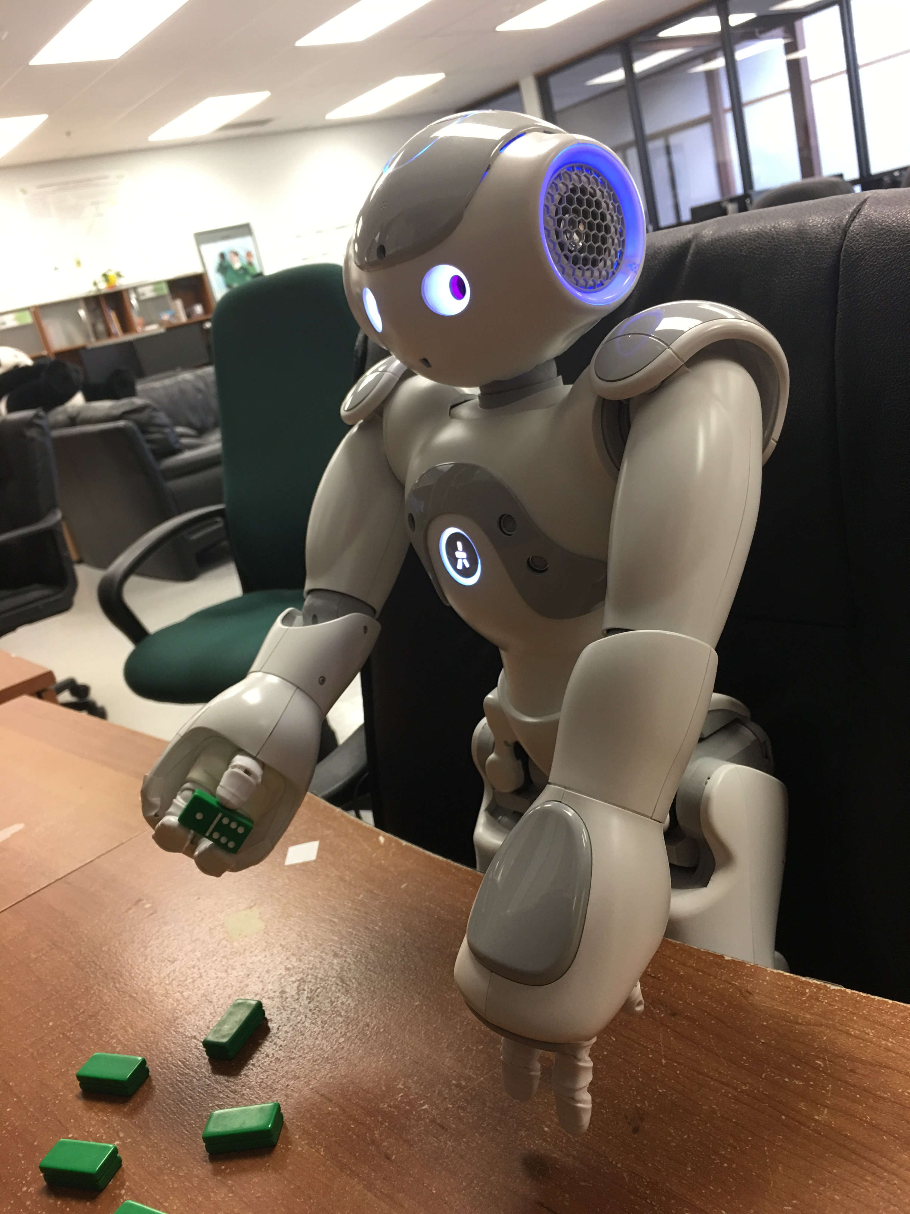
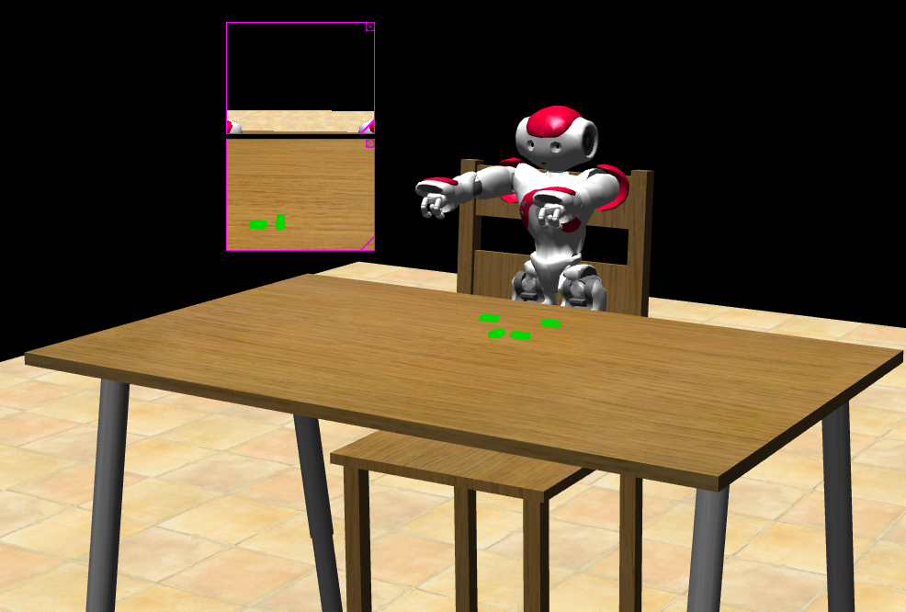
My Research Project
Playing game of Dominos with a Nao robot from human instructions.
Use Deep Transferring Reinforcement Learning to help with object grasping

Slide 25
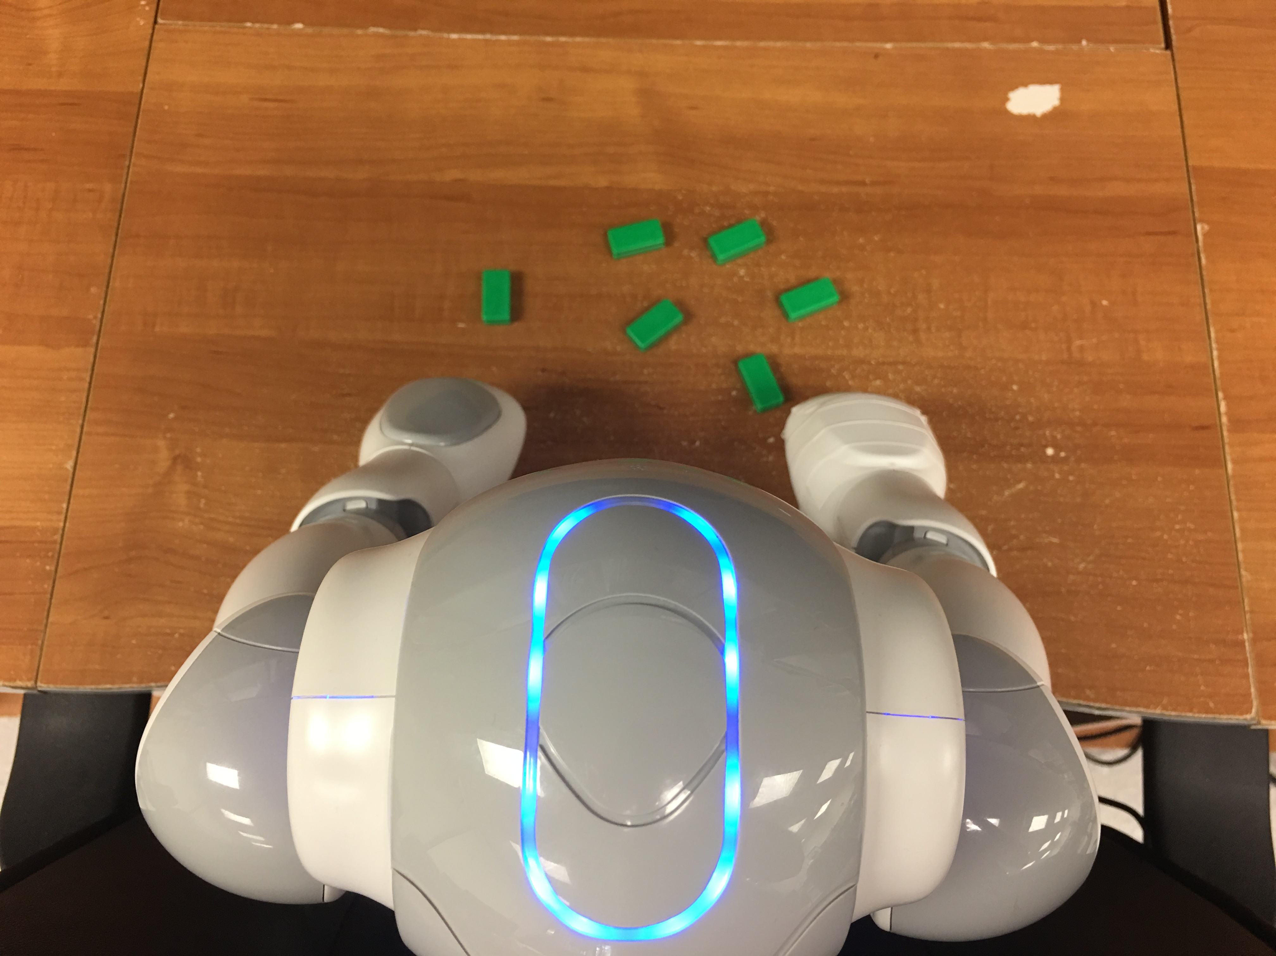
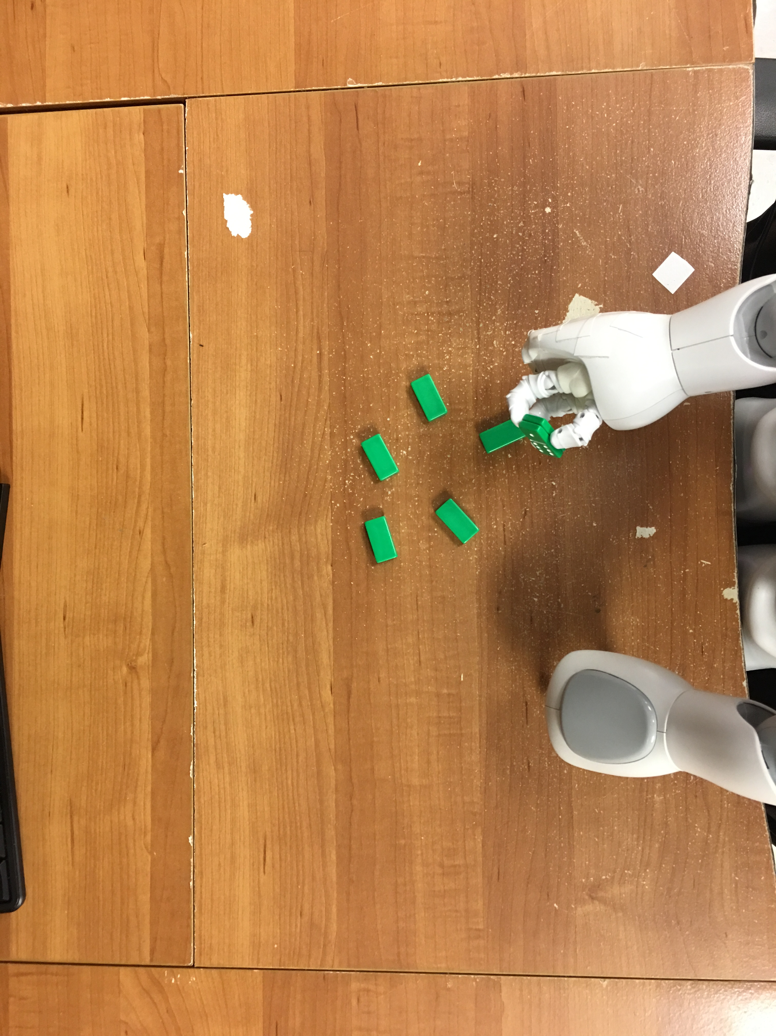
Deep Transferring Reinforcement Learning

Slide 26
My Research
Our goal is to have a single AI that can handle Kinematics, Language, Game Playing, and Human Interaction

Slide 27
Questions
?

